Slide 1
Advanced Angular
Fundamentals
Lecture 1
By James(Jin) Wang
10/05/2019

Slide 2
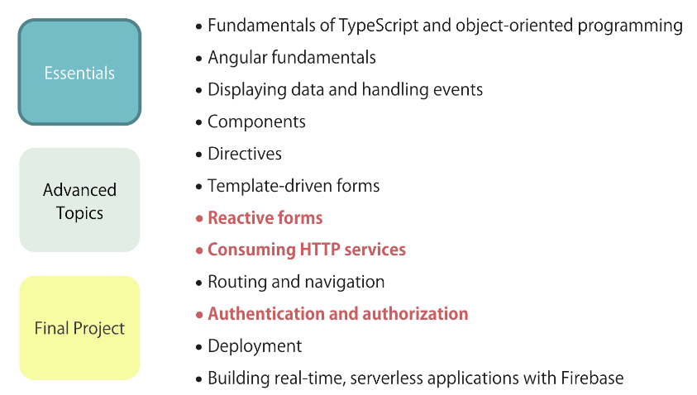
Big Picture

Slide 3
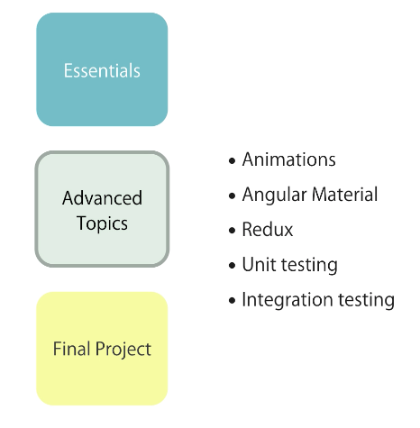
Big Picture

Slide 4
Outline
Components
Templates
Directives
Services

Slide 5
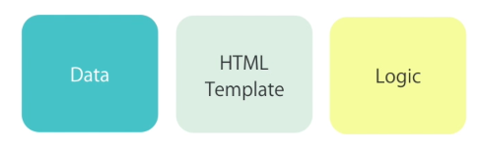
Components
  Component:

Slide 6
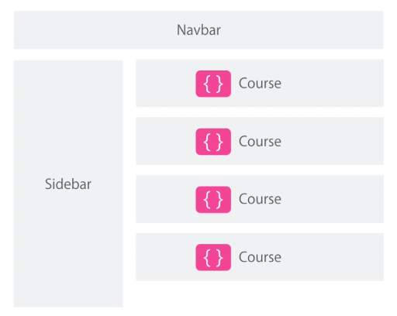
Components
  Component example:

Slide 7
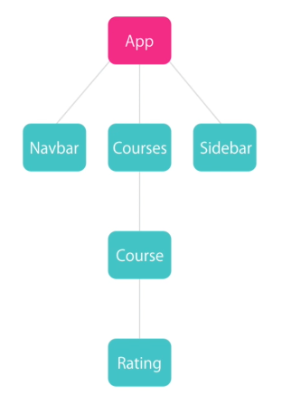
Components
  Component example:

Slide 8
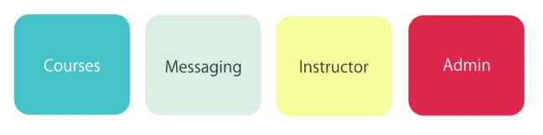
Components
  Modules:

Slide 9
Components
  What are the Alternatives?
  Create a component
  Register it in a module
  Add an element in an HTML markup

Slide 10
Demo
  ng new hello-world
  ng serve -o
  ng g c courses

Slide 11
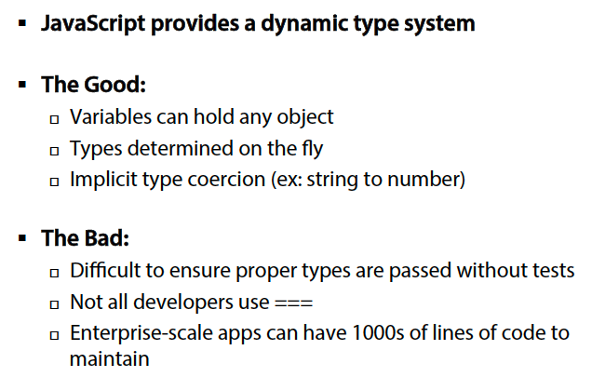
Why use TypeScript
  JavaScript Dynamic Types:

Slide 12

Why use TypeScript
  Migrating from Server-Side to Client-Side:
  Migrating from server-side apps to client-side apps can be challenging

Slide 13
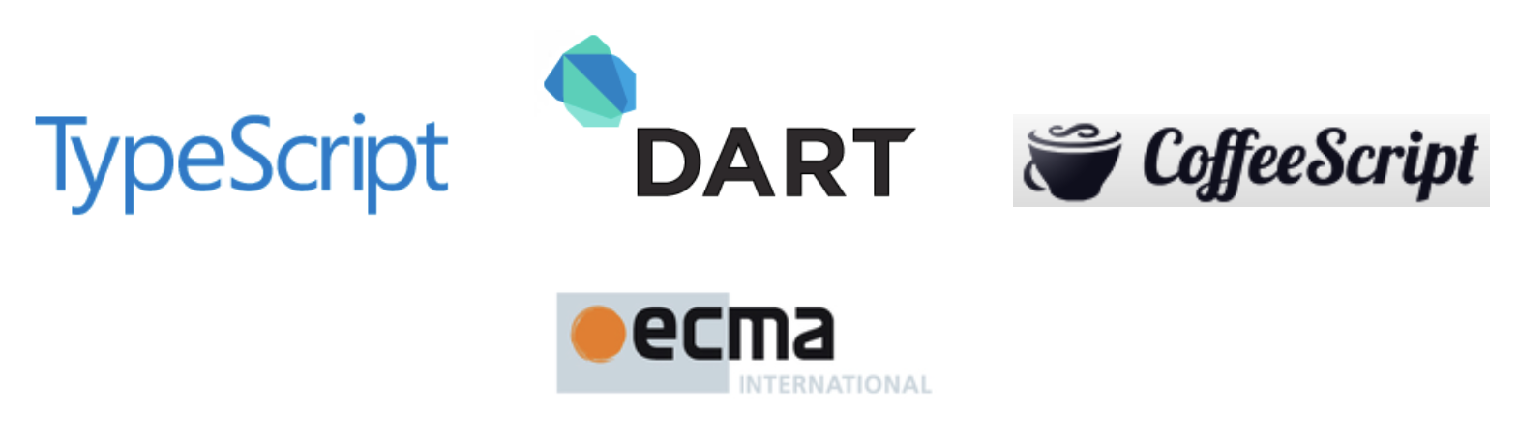
Why use TypeScript
  What are the Alternatives?
  Several TypeScript alternatives exist:
  Write pure JavaScript
  Apply JavaScript patterns
  CoffeeScript
  Dart

Slide 14
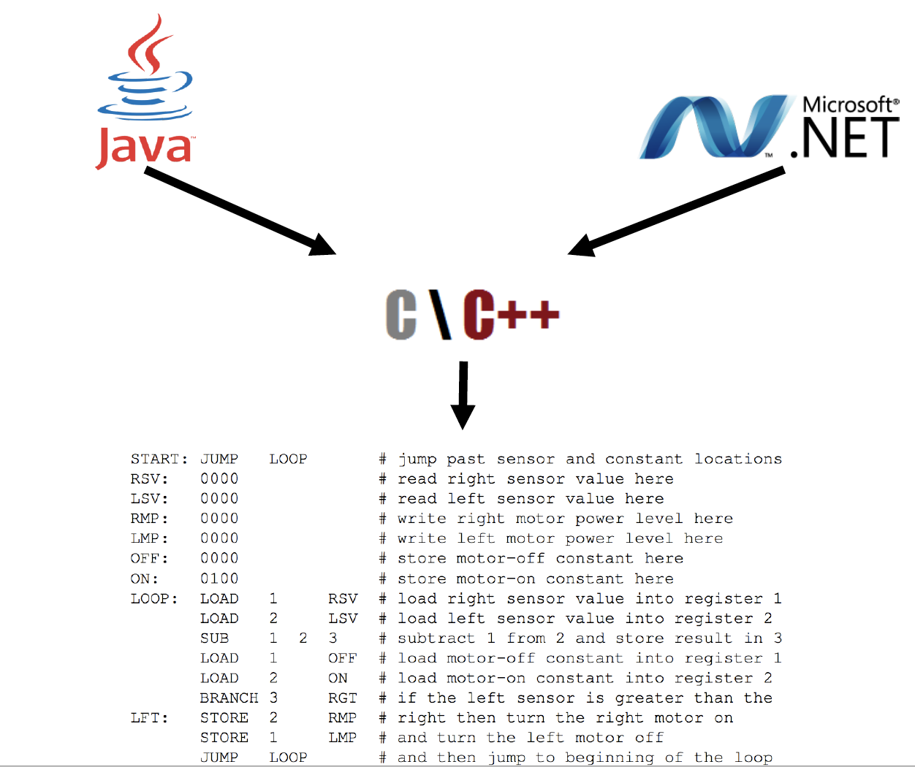
Why use TypeScript
  Should we Simply Write Plain JavaScript?

Slide 15

TypeScript Features
  What is TypeScript?

Slide 16
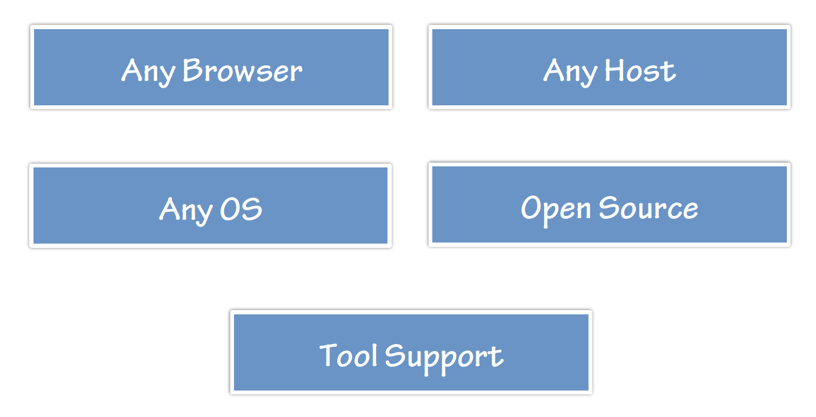
TypeScript Features
  Flexible Options:

Slide 17
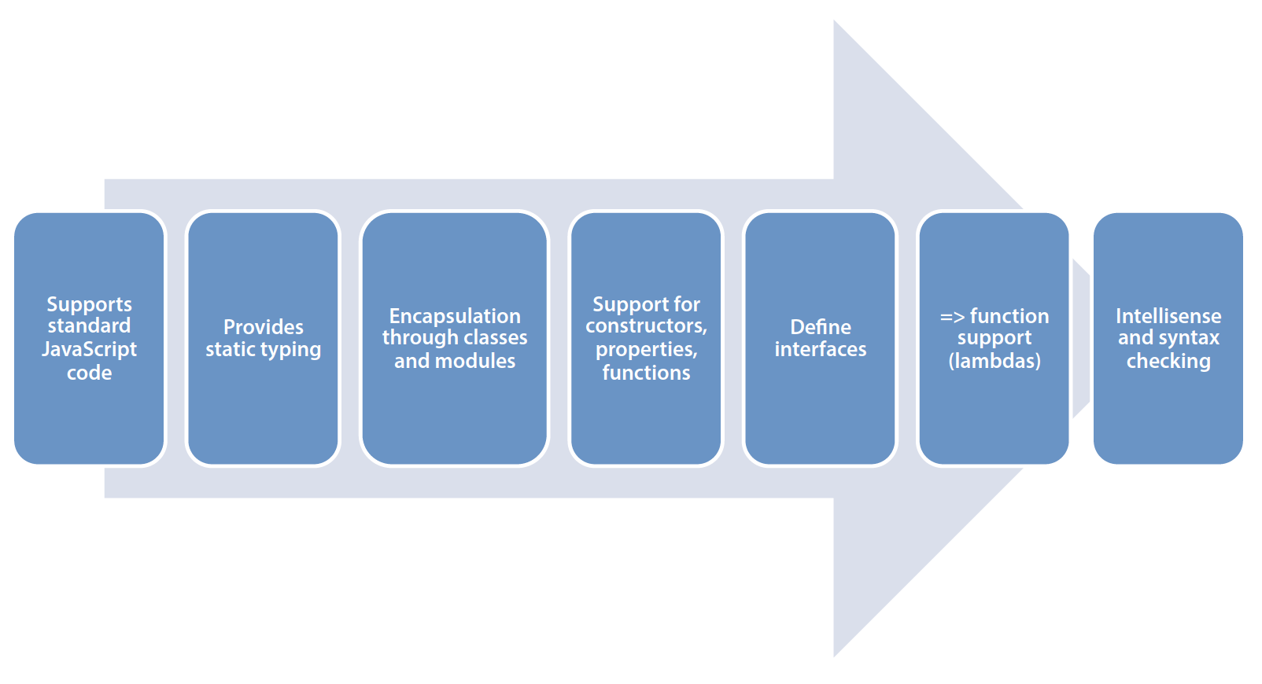
TypeScript Features
  Key TypeScript Features:

Slide 18
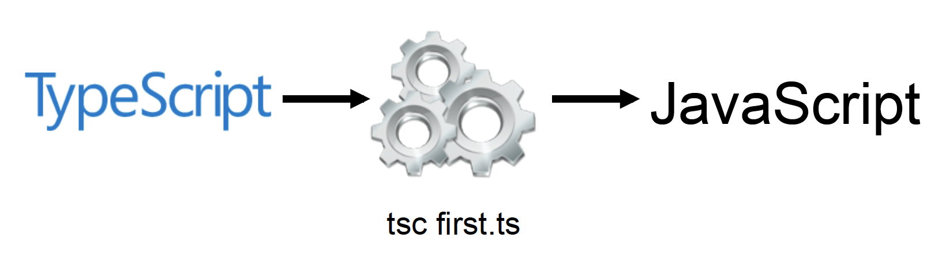
TypeScript Features
  TypeScript Compiler:

Slide 19
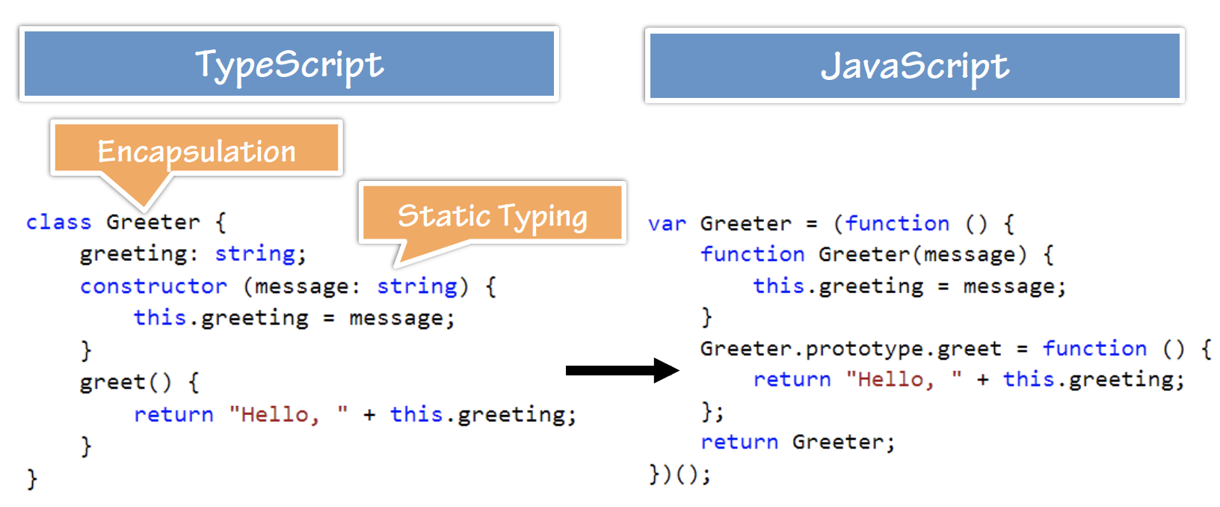
TypeScript Features
  TypeScript -> JavaScript:
  Demo: Greeter

Slide 20
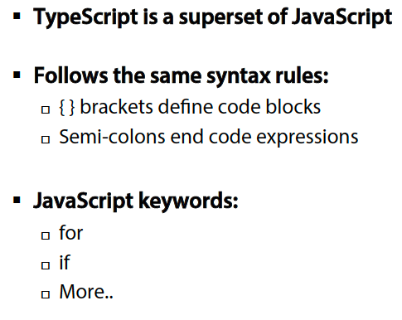
TypeScript Syntax, Keywords and Code Hierarchy
  TypeScript Syntax Rules:

Slide 21
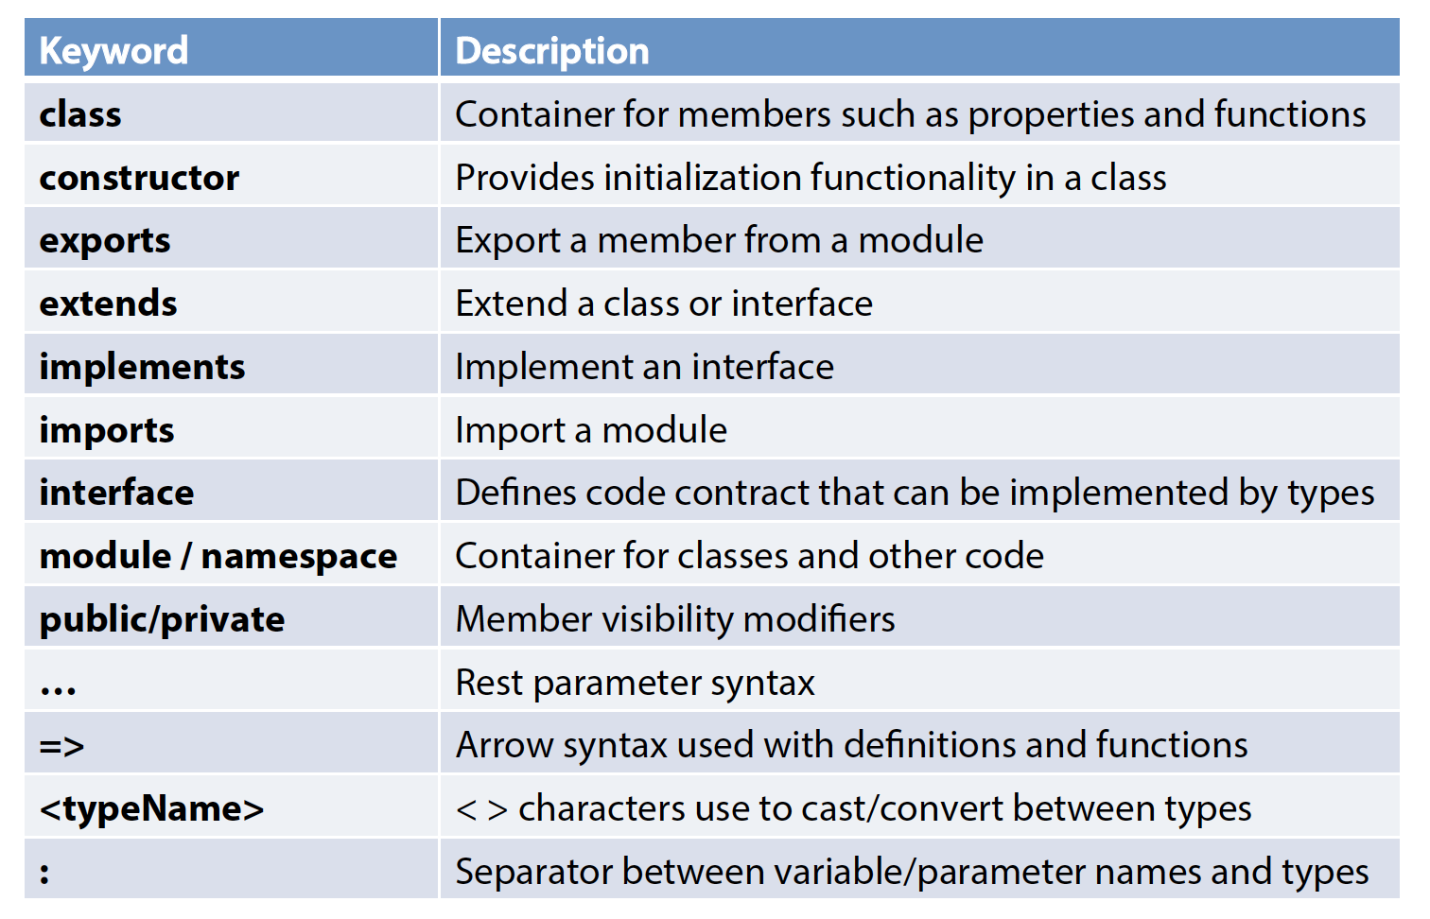
TypeScript Syntax, Keywords and Code Hierarchy
  Important Keywords and Operators:

Slide 22
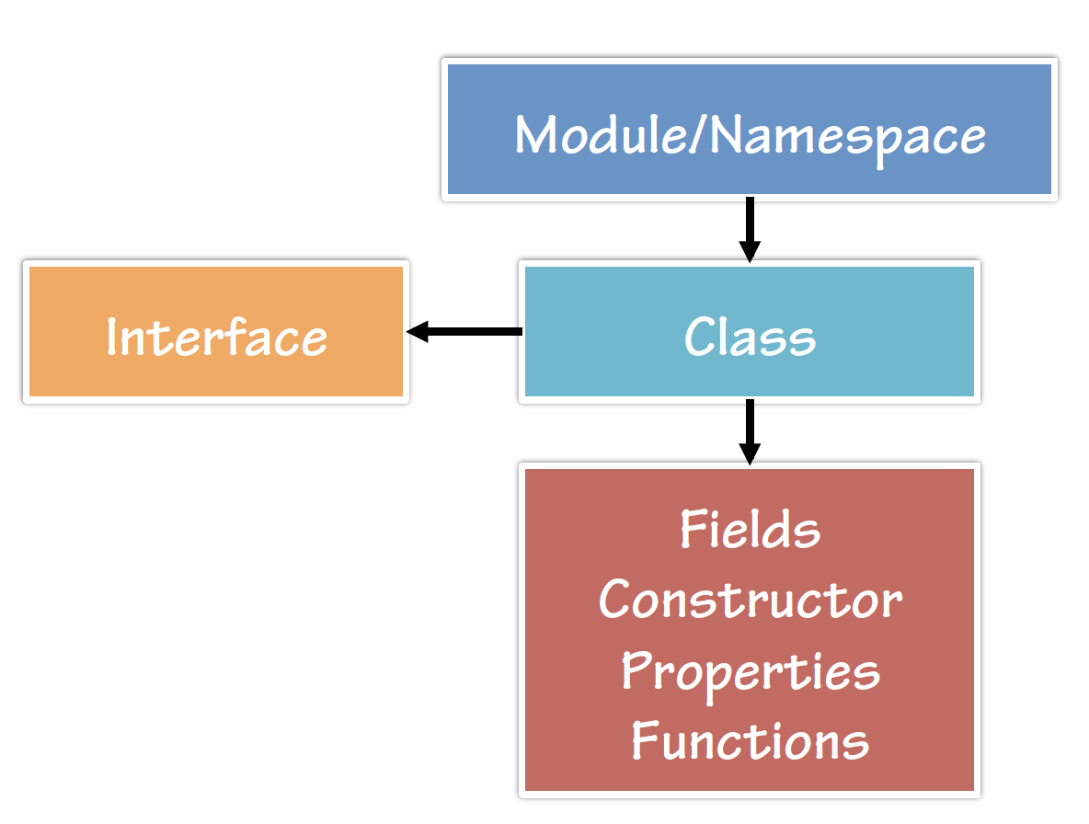
TypeScript Syntax, Keywords and Code Hierarchy
  Code Hierarchy:

Slide 23
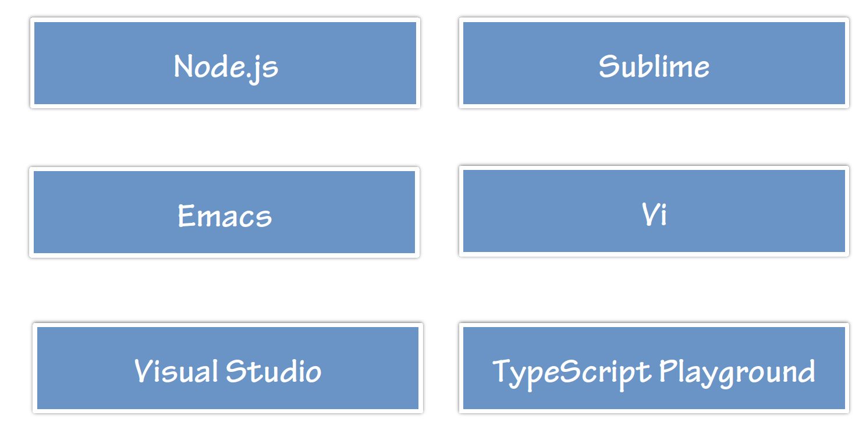
Tooling/Framework Options
  Tool/Framework Support:

Slide 24
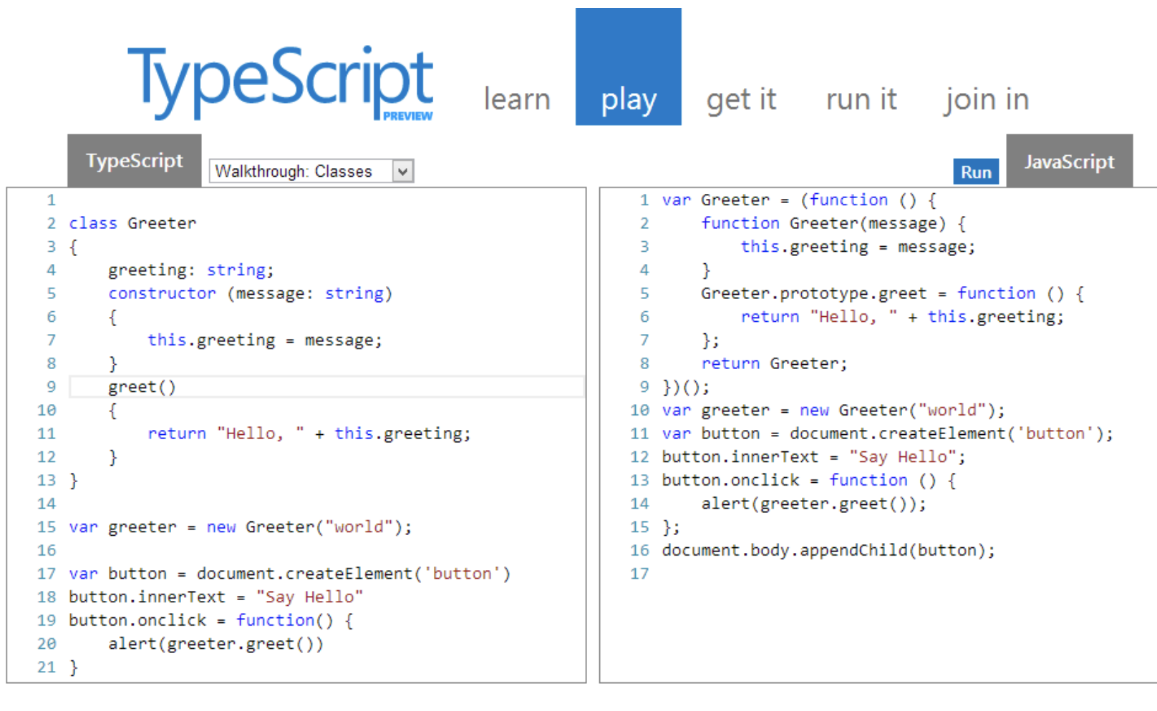
Tooling/Framework Options
  Demo: HelloWorld

Slide 25
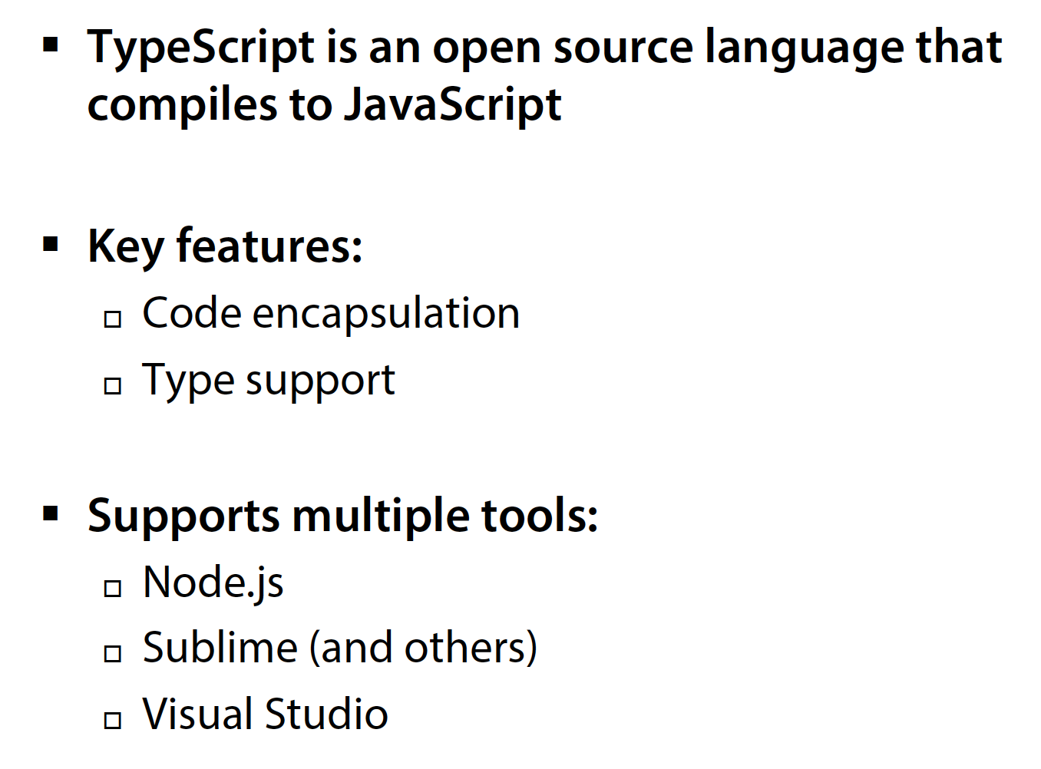
Summary

